Slide 1
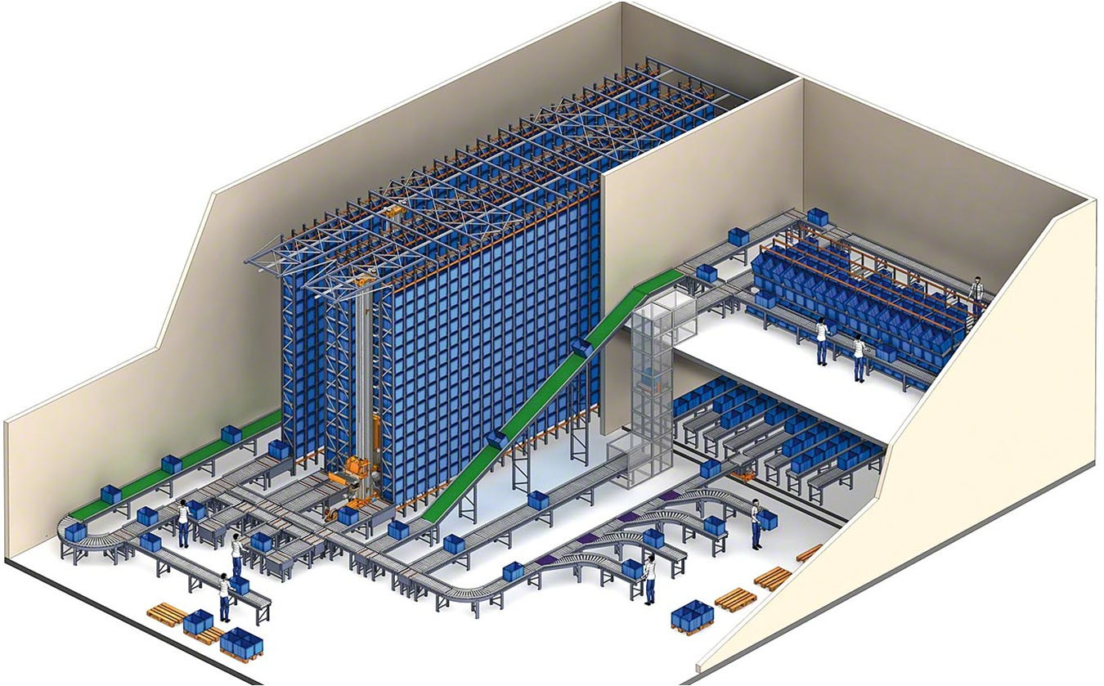



INTRALOGISTIC SOLUTION: CONVEYOR, RACKING, SORTER SYSTEM

Slide 2


Project information:
Project name: Scaling System
Date: Aug 2022
Investor: framas Vietnam Co.,Ltd
Supplier: AVS Co.,Ltd

Slide 3

From:
Mr Tao Van An
Director – 0989 514 905 Au Viet System Co.,Ltd
To:
Mr Dat Quan 0834 456 799
QA Manager
framas Vietnam Co.,Ltd

Slide 4

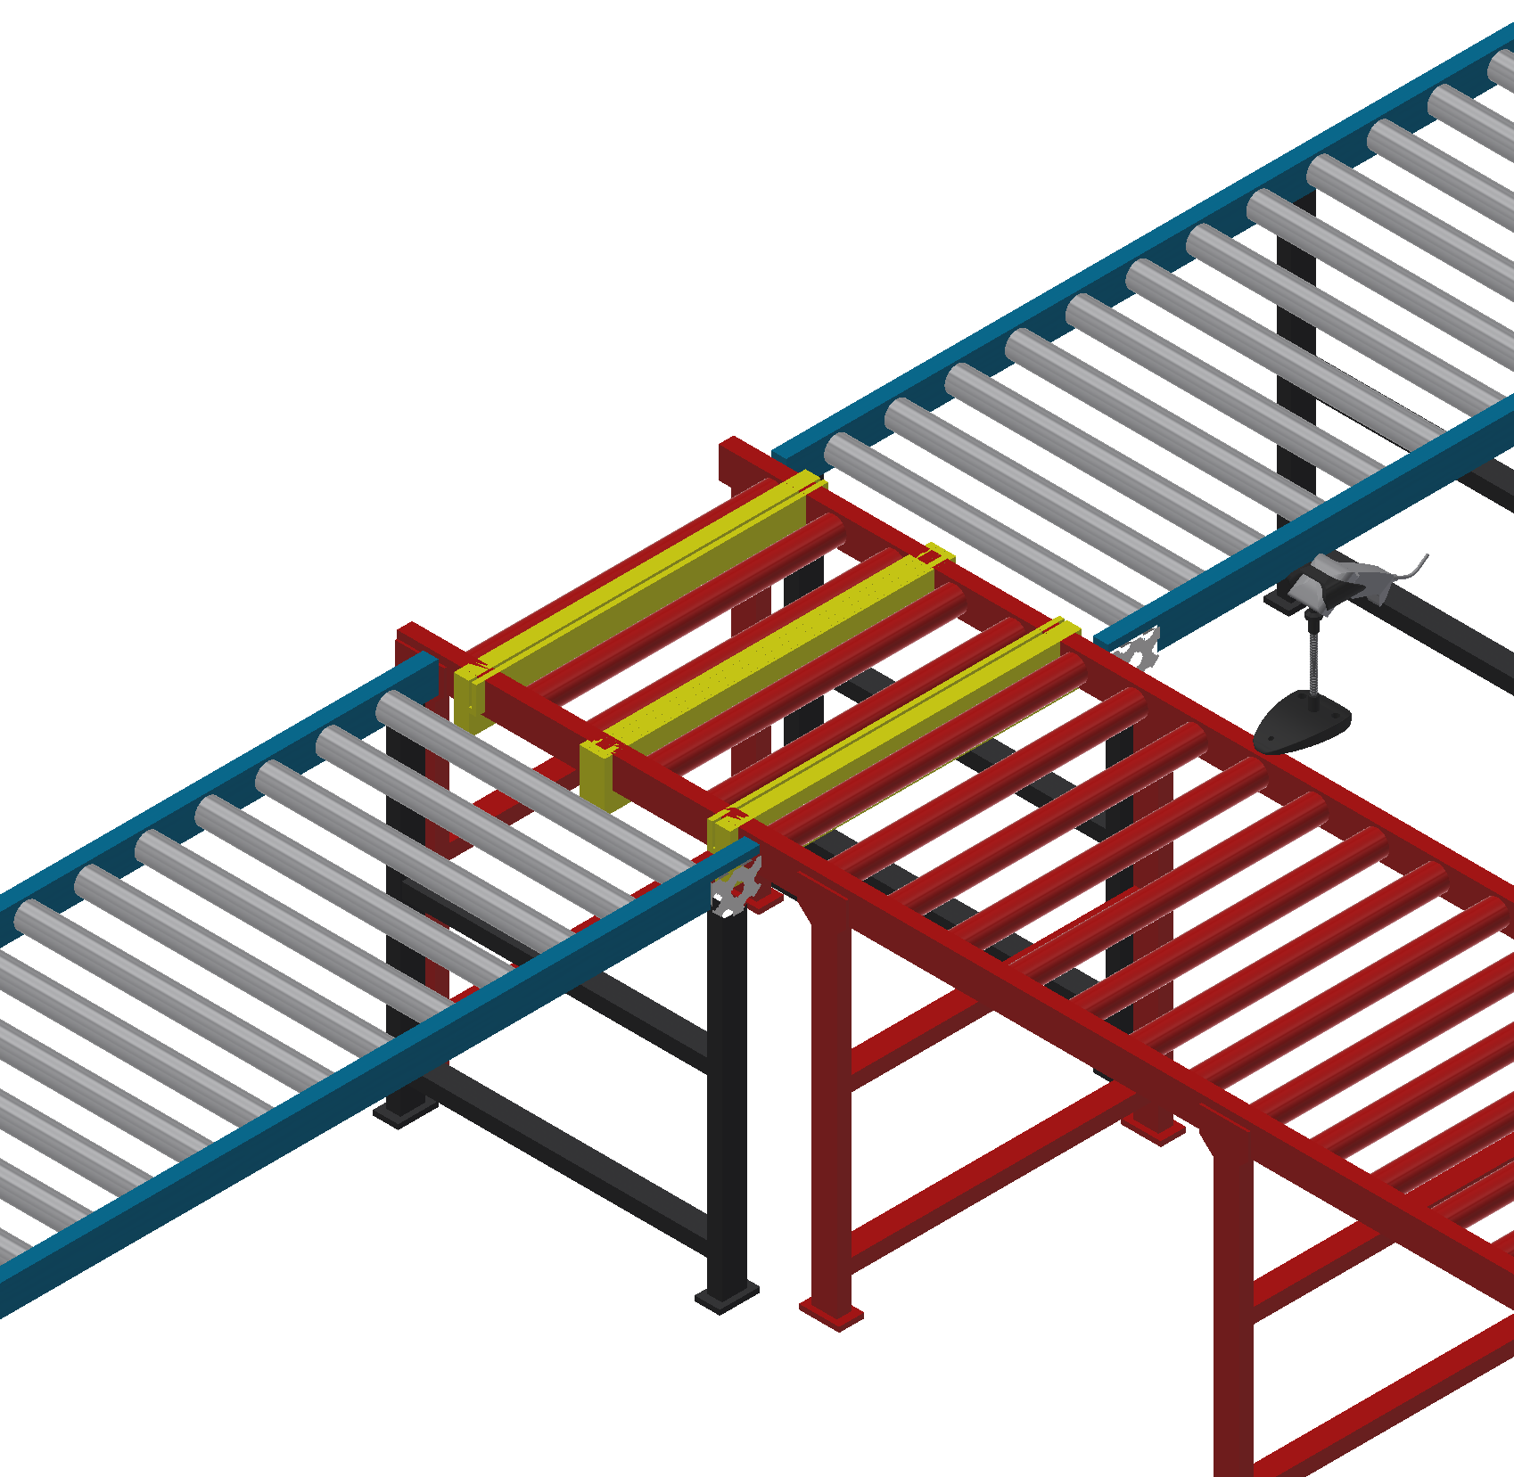
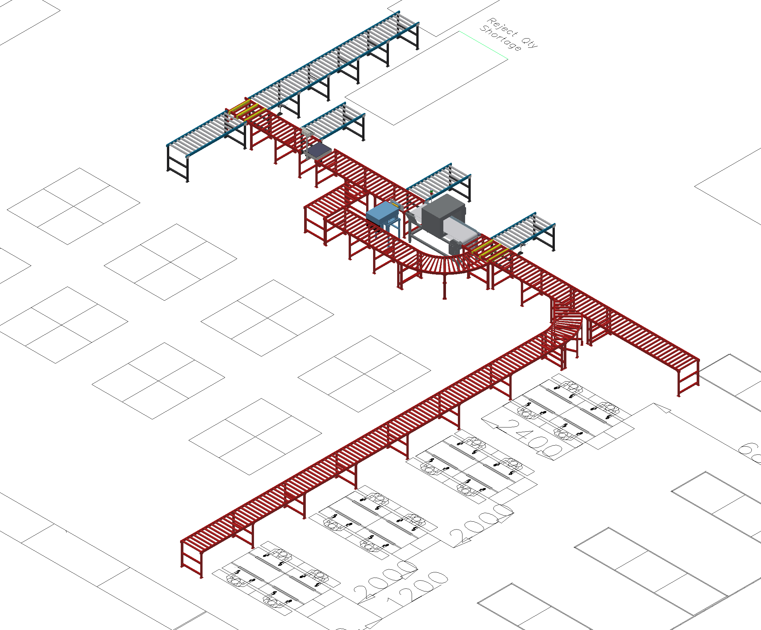
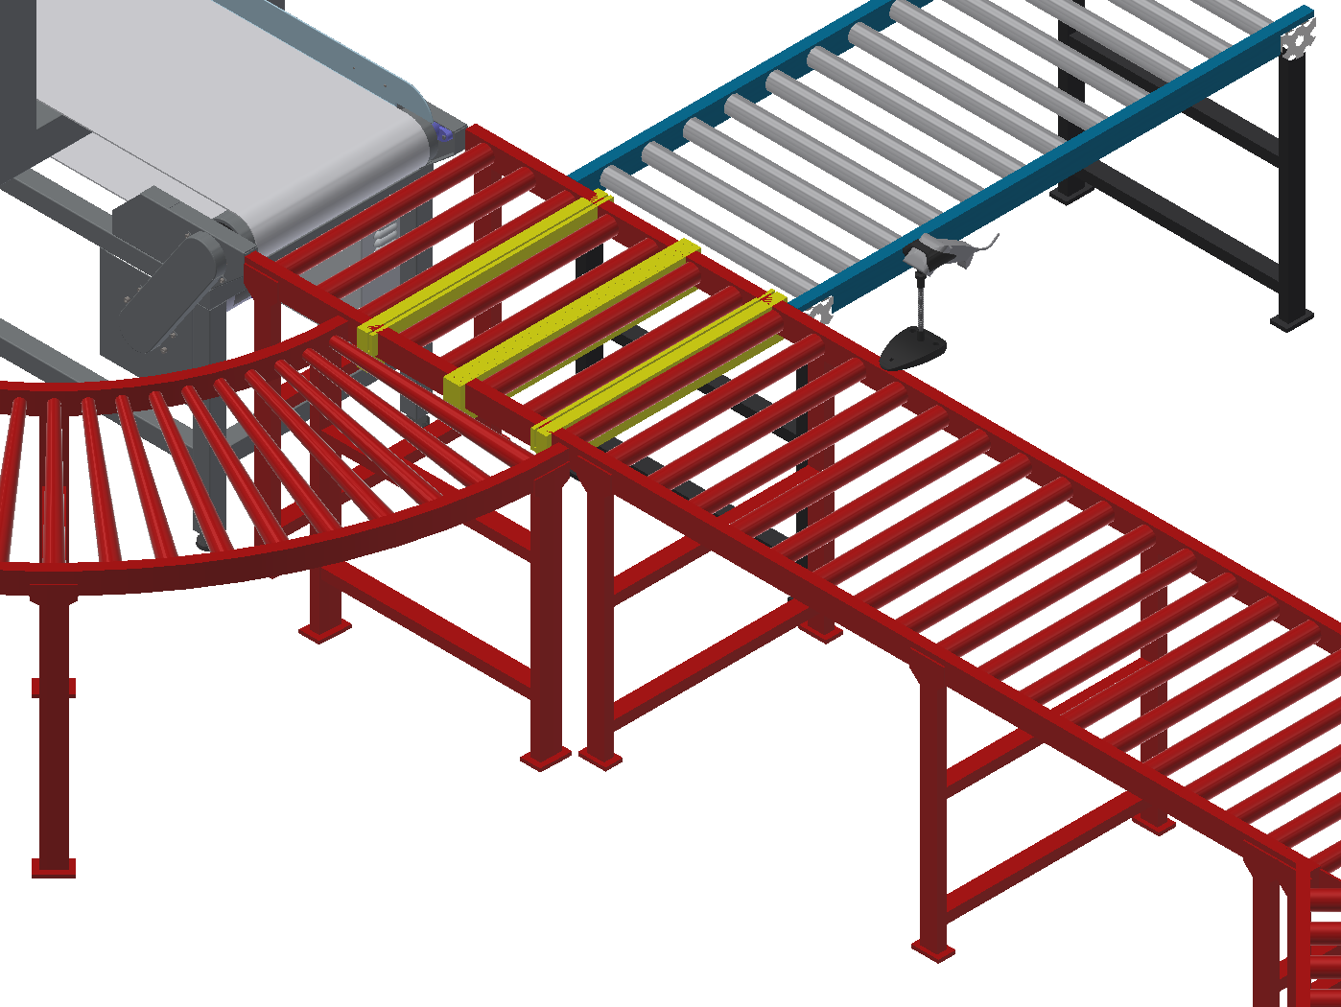
Layout
Transfer 1: 2-way
Turn Left: for Printing process
Turn Right: for FGs storage
Transfer 1: 3-way
Go straight: read barcode and check metal
Turn Left: can’t read barcode
Turn Right: Read barcode and no check metal

Slide 5
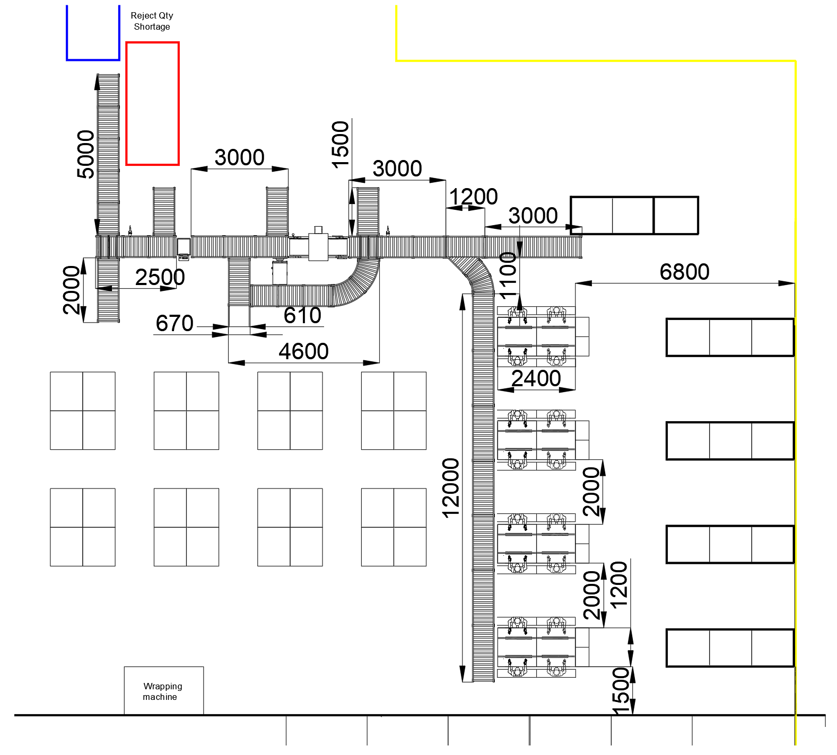
Layout
Please check finished dimension by CAD file

